Slide 1
Subset Comparison (A vs B)

Slide 2
Subset 1
"A01", "A04", "A14", "A16", "A25", "A26", "A30", "A31", "A41", "A50“
out of 24048 with nonzero total read count
adjusted p-value < 0.1
LFC > 0 (up) : 474, 2%
LFC < 0 (down) : 1653, 6.9%
outliers [1] : 0, 0%
low counts [2] : 1386, 5.8%
(mean count < 5)

Slide 3
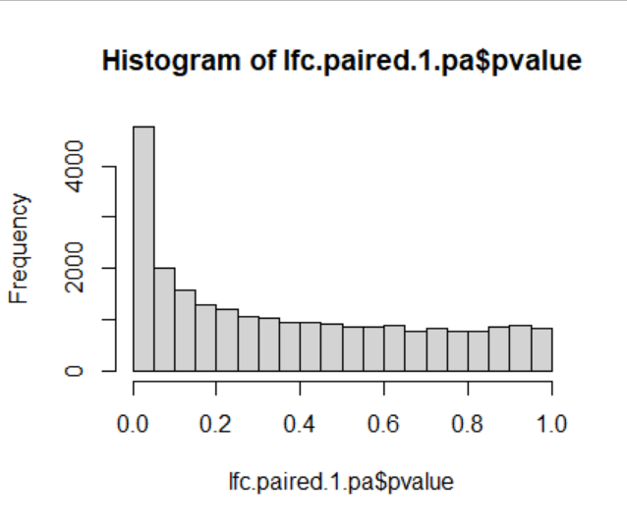
Subset 1

Slide 4
Subset 2
"A05", "A19", "A20", "A36", "A38", "A43", "A51", "A57“
out of 24013 with nonzero total read count
adjusted p-value < 0.1
LFC > 0 (up) : 154, 0.64%
LFC < 0 (down) : 472, 2%
outliers [1] : 0, 0%
low counts [2] : 13379, 56%
(mean count < 206)

Slide 5
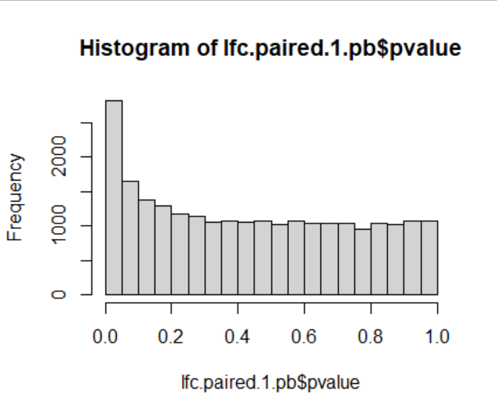
Subset 2

